Slide 1
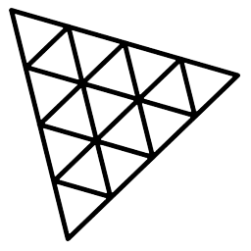
Three.js
3.JS
is
awesome
GUIDE FOR BEGINNERS
PROJECT PROPOSAL

Slide 2
TOPIC 16:
ABOUT
BUDGET
PROJECT
TIMELINE
PARTICLES
PROJECT PROPOSAL

Slide 3
USES OF PARTICLES
TABLE OF CONTENTS
BASIC SCENE WITH PARTICLES
PROPERTIES
Uses of particles
Basic scene with particles
Properties
01
02
03
PROJECT PROPOSAL

Slide 4

Uses of Particles
Uses of particles
Basic scene with particles
Properties
01

Slide 5
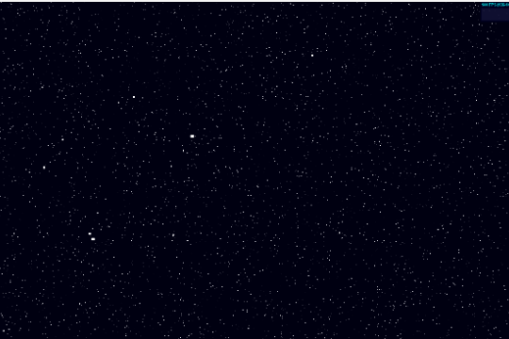
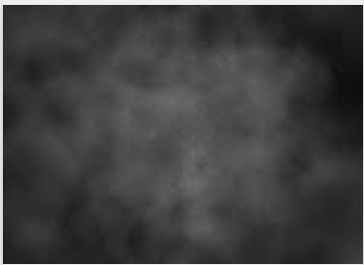

Uses of particles
Basic scene with particles
Properties
Particle systems are collections of thousands of small objects that are used to achieve various effects such as stars, smoke, rain, dust, fire, and many other things.
Following are the examples of how it looks like in threeJS.
Stars/rain
smoke
Fire

Slide 6

Basic Scene with particles
Uses of particles
Basic scene with particles
Properties
02

Slide 7

Uses of particles
Basic scene with particles
Properties
const canvas=document.getElementById('webgl3');
const scene=new THREE.Scene();
const camera=new THREE.PerspectiveCamera(50,window.innerWidth/window.innerHeight,1,1000)
scene.add(camera)
camera.position.set(0,-8,20)
const renderer=new THREE.WebGLRenderer({canvas:canvas})
renderer.setSize(window.innerWidth,window.innerHeight)
renderer.render(scene,camera)
const partGeo=new THREE.SphereGeometry(1,32,32)
const particlesMaterial=new THREE.MeshBasicMaterial({});
const obj=new THREE.Mesh(partGeo, particlesMaterial);
scene.add(obj)

Slide 8

Uses of particles
Basic scene with particles
Properties
const canvas=document.getElementById('webgl3');
const scene=new THREE.Scene();
const camera=new THREE.PerspectiveCamera(50,window.innerWidth/window.innerHeight,1,1000)
scene.add(camera)
camera.position.set(0,-8,20)
const renderer=new THREE.WebGLRenderer({canvas:canvas})
renderer.setSize(window.innerWidth,window.innerHeight)
renderer.render(scene,camera)
const partGeo=new THREE.SphereGeometry(1,32,32)
const particlesMaterial=new THREE.PointsMaterial({});
const obj=new THREE.Points(partGeo, particlesMaterial);
scene.add(obj)

Slide 9
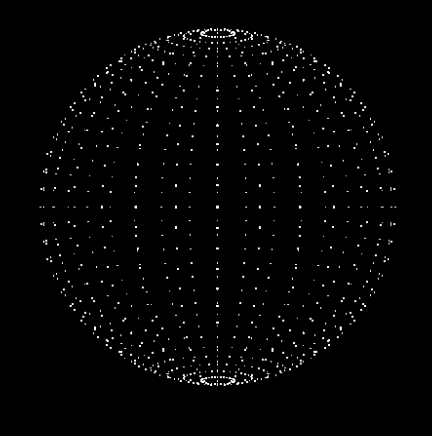
Uses of particles
Basic scene with particles
Properties
const canvas=document.getElementById('webgl3');
const scene=new THREE.Scene();
const camera=new THREE.PerspectiveCamera(50,window.innerWidth/window.innerHeight,1,1000)
scene.add(camera)
camera.position.set(0,-8,20)
const renderer=new THREE.WebGLRenderer({canvas:canvas})
renderer.setSize(window.innerWidth,window.innerHeight)
renderer.render(scene,camera)
const partGeo=new THREE.SphereGeometry(1,32,32)
const particlesMaterial=new THREE.PointsMaterial({});
//const particlesMaterial=new THREE.PointsMaterial({size:0.02});
const obj=new THREE.Points(partGeo, particlesMaterial);
scene.add(obj)

Slide 10

Uses of particles
Basic scene with particles
Properties
const canvas=document.getElementById('webgl3');
const scene=new THREE.Scene();
const camera=new THREE.PerspectiveCamera(50,window.innerWidth/window.innerHeight,1,1000)
scene.add(camera)
camera.position.set(0,-8,20)
const renderer=new THREE.WebGLRenderer({canvas:canvas})
renderer.setSize(window.innerWidth,window.innerHeight)
renderer.render(scene,camera)
const partGeo=new THREE.SphereGeometry(1,32,32) const particlesMaterial=new THREE.PointsMaterial({});
//const particlesMaterial=new THREE.PointsMaterial({size:0.02});
const count=5000;
const pos= new Float32Array(count) for(let i=0;i<count;i++){
pos[i]=(Math.random()-0.5)*10;
}
partGeo.setAttribute('position',new THREE.BufferAttribute(pos,3))
const obj=new THREE.Points(partGeo, particlesMaterial);
scene.add(obj)

Slide 11
Uses of particles
Basic scene with particles
Properties
setAttribute(): Sets an attribute to this geometry
Parameters: setAttribute(name:String,attribute:BufferAttribute)
Example: partGeo.setAttribute('position',new THREE.BufferAttribute(pos,3))
BufferAttribute():
Stores data for an attribute
Efficient way of passing data
Parameters: BufferAttribute(array,itemSize)
Example: new THREE.BufferAttribute(pos,3)
Why we use float32Array instead of simple array?
If arrays are generally small or number of operations on them is low then we use simple array. But if arrays are very large or are used for many operations then we use a typedArray.

Slide 12
Properties
Uses of particles
Basic scene with particles
Properties
03

Slide 13


Uses of particles
Basic scene with particles
Properties
// Material
const particlesMaterial = new THREE.PointsMaterial({
size: 0.02,
sizeAttenuation: true
})
Specify whether points' size is attenuated by the camera depth. (Perspective camera only.) Default is true.
sizeAttenuation:true
sizeAttenuation: false

Slide 14
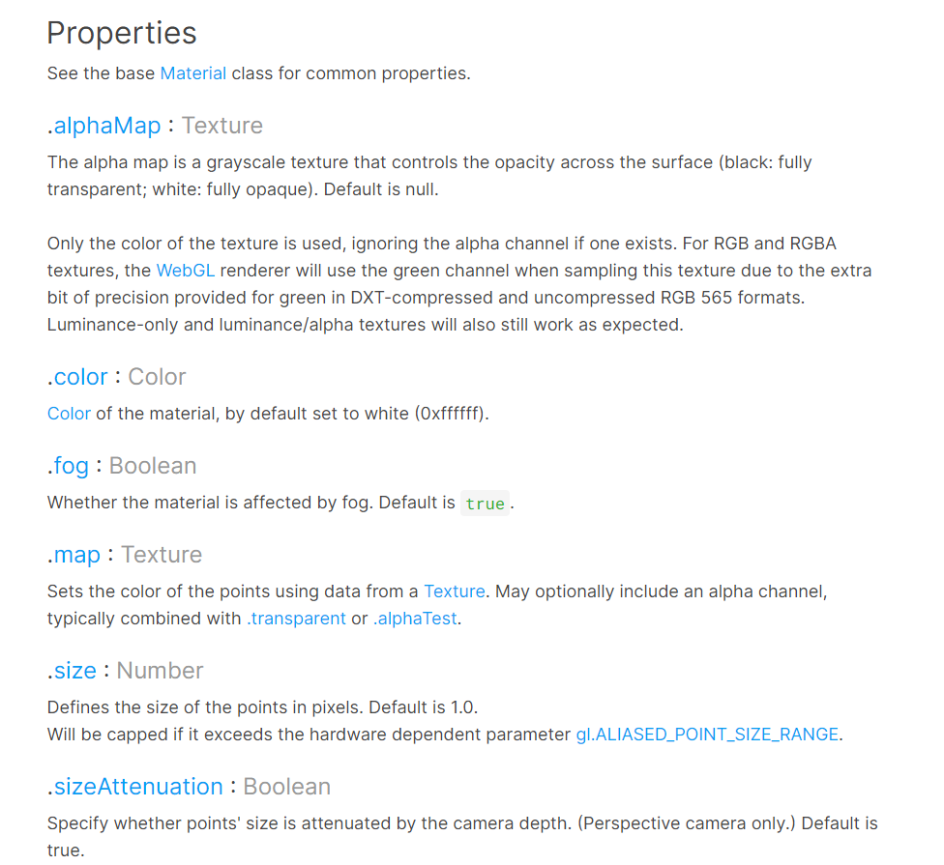
Uses of particles
Basic scene with particles
Properties

Slide 15
THANKS!
ABOUT
BUDGET
PROJECT
TIMELINE
Do you have any questions?
EMAIL: aadnanshahh2001@gmail.com
GITHUB: https://github.com/AdnanShahSahb
Please keep this slide for attribution
PROJECT PROPOSAL

